Slide 1
Agricultural Related Query Clarifier System
Name: VIJAI KUMAR S
Register No: 2020178060(R)
Batch: Batch 2
Project Guide: Dr.D.NARASHIMAN
Notes:
We designed this template so that each member of the project team has a set of slides with its own theme. Members, here’s how you add a new slide to just your set:
Mark where you want to add the slide: Select an existing one in the Thumbnails pane, click the New Slide button, then choose a layout. The new slide gets the same theme as the other slides in your set.
Careful! Don’t annoy your fellow presenters by accidentally changing their themes. That can happen if you choose a different theme from the Design tab, which changes all of the slides in the presentation to that look.

Slide 2
OBJECTIVE
Traditionally Field officers visit the farmlands and provide training, advice, and support to the farmers
Many of the rural villages misses this facility
Wastage of time and money spent on obtaining information or contacting officials
Nowadays many young generation people are come forward in Agricultural field
By this they are struggled to clarify their any basic doubts about farming. Lots of people are calling Kissan Call Centre (Owned by Government) to clarify their basic doubts

Slide 3
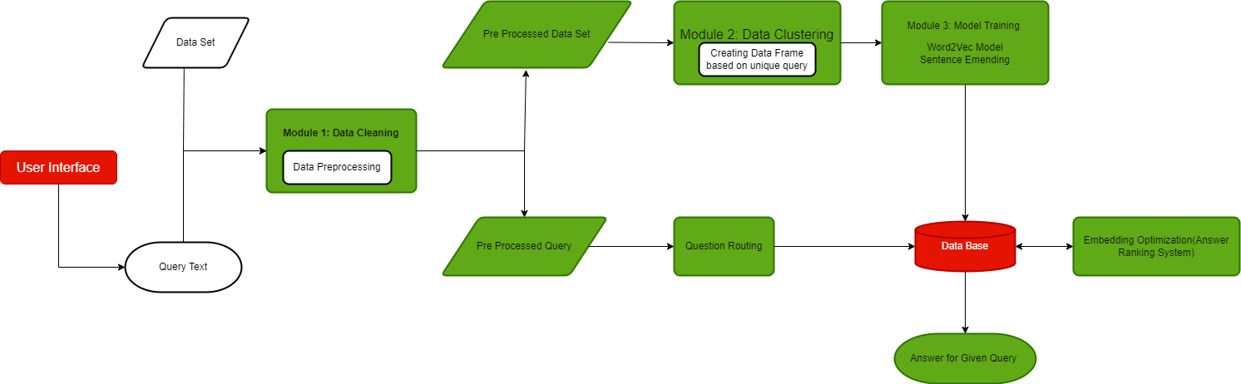
ARCHITECTURE DIAGRAM

Slide 4
Detailed Module Design
Data Cleaning
Text Clustering
Training Module

Slide 5
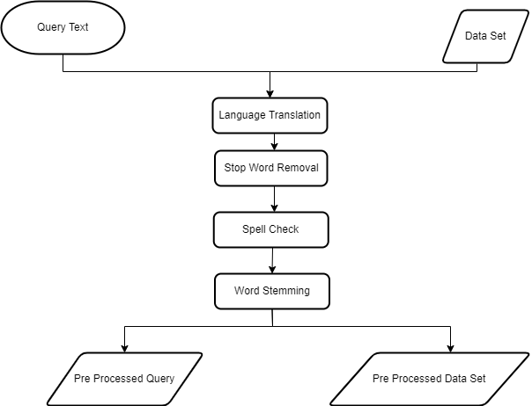
Data Cleaning
Data Flow Diagram:

Slide 6

Sample Input:
{"Season":"RABI","Sector":"AGRICULTURE","Category":"Others","Crop":"Others","QueryType":"Government Schemes", "QueryText":"FARMER ASKED ABOUT PM KISAN?", "KccAns":"पीएमकिसानसाठीतुमच्याजवळीलतहसीलऑफिसलाजाऊनभेटद्यावीधन्यवाद", "StateName":"GOA", "DistrictName":"GOA SOUTH","BlockName":"SANGUEM","CreatedOn":"2022-04-01T10:47:15.43"}

Slide 7

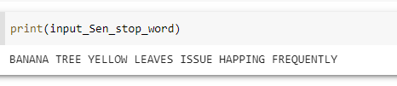
Stop Word Removal
from nltk.corpus import stopwords
from nltk.tokenize import word_tokenize
stop_word = set(stopwords.words("english")) UserQuery = list(input_Sen.split(" ")) UserQuery = " ".join(str(x) for x in UserQuery)
UserQuery = UserQuery.lower() UserQuerys = word_tokenize(UserQuery) filtered_sentenceQuery = [w.upper() for w in UserQuerys if not w in stop_word] filtered_sentenceQuery = " ".join(str(x) for x in filtered_sentenceQuery) input_Sen_stop_word = filtered_sentenceQuery
Input
Output

Slide 8
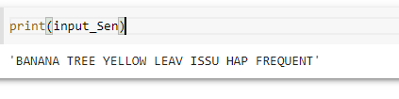
Word Stemming
from nltk.stem import PorterStemmer
ps = PorterStemmer() new_lst = []
Query = (input_Sen_translated)
Query = str(Query)
Query = list(Query.split(" ")) listlen1 = len(Query) for y in range(listlen1):
steming = ps.stem(Query[y]).upper()
new_lst.append(steming)
listToStr = ' '.join([str(elem) for elem in new_lst]) input_Sen = listToStr
Input:
Output

Slide 9
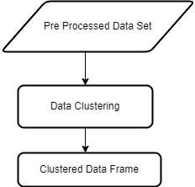
Text Clustering
All the Unique Query separated and Query Type, Category, State Name, District Name, Created Date, and all the Answer for the particular query are clustered together by the below algorithm,
Algorithm:
total_dictionary = {}
with open('/content/drive/MyDrive/project/Data Set/Final_merged1.csv') as fin:
reader = csv.DictReader(fin)
for row in reader:
values = [row['QueryType'], row['StateName'],row['DistrictName'],row['CreatedOn'],row['Answer']]
query = row['Query']
query = (" ".join(query.split()))
# branches[row['River Name']].append(branch)
total_dictionary.setdefault(query, [])
total_dictionary[query].append(values)
with open('/content/drive/MyDrive/project/Data Set/Final_merged2.csv') as fin:
reader = csv.DictReader(fin)
for row in reader:
values = [row['QueryType'], row['StateName'],row['DistrictName'],row['CreatedOn'],row['Answer']]
query = row['Query']
query = (" ".join(query.split()))
# branches[row['River Name']].append(branch)
total_dictionary.setdefault(query, [])
total_dictionary[query].append(values)
with open('/content/drive/MyDrive/project/Data Set/Final_merged3.csv') as fin:
reader = csv.DictReader(fin)
for row in reader:
values = [row['QueryType'], row['StateName'],row['DistrictName'],row['CreatedOn'],row['Answer']]
query = row['Query']
query = (" ".join(query.split()))
# branches[row['River Name']].append(branch)
total_dictionary.setdefault(query, [])
total_dictionary[query].append(values)

Slide 10
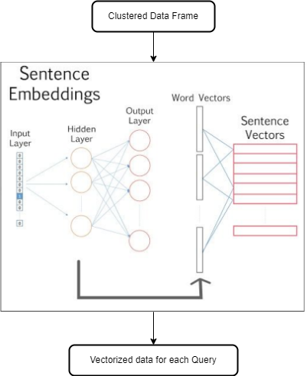
Training Model
Algorithm:
model_name = 'bert-base-nli-mean-tokens'
from sentence_transformers import SentenceTransformer
model = SentenceTransformer(model_name)
sentence_vecs = model.encode(lis)
save the model to disk
filename = 'finalized_model.sav'
pickle.dump(sentence_vecs, open(filename, 'wb'))
filename = '/content/drive/MyDrive/project/Data Set/finalized_model.sav'
loaded_model = pickle.load(open(filename, 'rb'))
from sklearn import metrics
from sklearn.metrics.pairwise import cosine_similarity
input_Sen = model.encode(input_Sen)
similarity = cosine_similarity(
[input_Sen], loaded_model[1:]
)
maximum = max(similarity)
maxi = max(maximum)
print(maxi)
index_of_maximum = np.where(maxi == maximum)
Query_index = index_of_maximum[0][0]+1
print(Query_index)

Slide 11

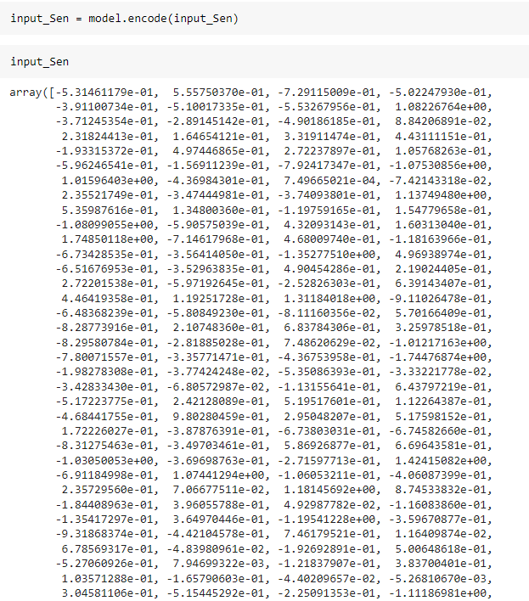
Training Model
Input:
Output:

Slide 12
User Registration/Login
The user module allows users to register, log in, and log out.
In this module user can give their location and basic details which helps for retrieval of data
Users benefit from being able to sign on because this associates content they create with their account and allows various permissions to be set for their roles.

Slide 13
Evaluation Metrics
In order to evaluate our metric, for the prediction of the test data questions. Using these predictions and the ground truth we can define a threshold for both scores. The threshold tells the model which predictions are to be considered as good results. By using the metrics for ranking our answers, where the final predicted answer is given by
Output answer = argmax [score (question, answeri)]

Slide 14
Reference
Reference:
Bikel, Daniel M, Richard Schwartz and Ralph M. Weischedel, “ An algorithm that learns what’s in a name”. Machine Learning 1999 Issue No.34 pp. 211–2, 1999.
Sanjeev Arora, Yingyu Liang, Tengyu Ma, “A simple but tough-to-beat baseline for sentence embedding's”, in the proceeding of International Conference on Learning Representations, 2017
Xiaoxue Shen , Adele Lu Jia, Siqi Shen and Yong Dou, “Helping the Ineloquent Farmers: Finding Experts for Questions with Limited Text” Volume 8 2020.
SerhadSarica ,JianxiLuo “Stopwords in technical language processing”. Journal PLOS ONE August 2021
Banerjee, S., Pedersen, T., An adapted Lesk algorithm for word sense disambiguation using WordNet (2002)
Ming Che Lee,1 Jia Wei Chang,2 and Tung Cheng Hsieh3A “Grammar-Based Semantic Similarity Algorithm for Natural Language Sentences” Hindawi Publishing Corporation, The Scientific World Journal Volume 2014, Article ID 437162,17 pages.

